Slide 1


Impact logic and target group-oriented communication

Slide 2
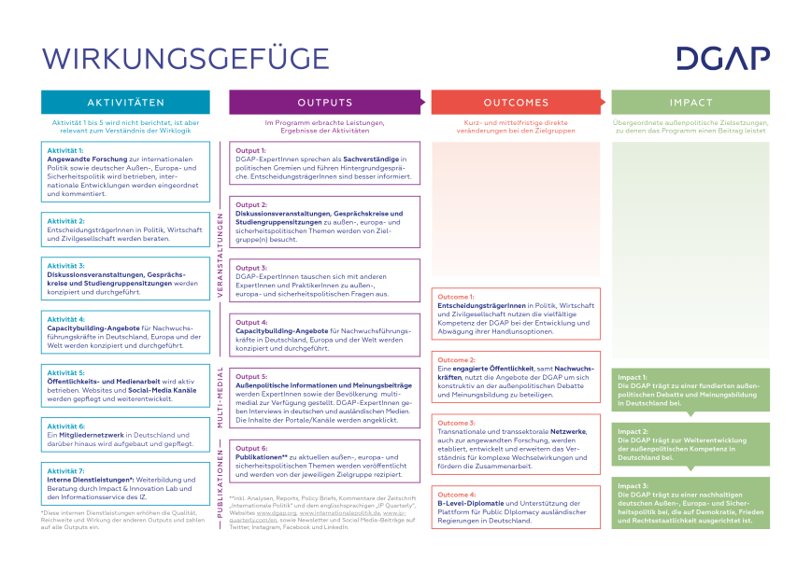
OUTCOME 1
Decision-makers in politics, business, the foreign policy community and civil society use DGAP's diverse expertise to develop and weigh up their options for action.
in developing and weighing up their options for action.

Slide 3
OUTCOME 1
Decision-makers in politics, business, the foreign policy community and civil society use DGAP's diverse expertise to develop and weigh up their options for action.
in developing and weighing up their options for action.

Slide 4
Outcome 2
A committed public, including young professionals, uses the DGAP's services to participate constructively in the foreign policy debate and opinion-forming process.

Slide 5
Outcome 3
Transnational and transsectoral network(s), also for applied research, expand the understanding of complex interactions and promote cooperation.

Slide 6
Outcome 4
B-level diplomacy & support of/platform for public diplomacy
of foreign governments in Germany.

Slide 7
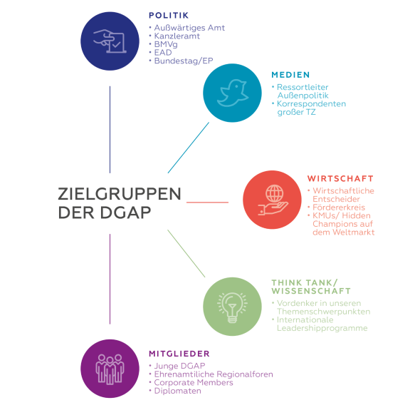

Slide 8
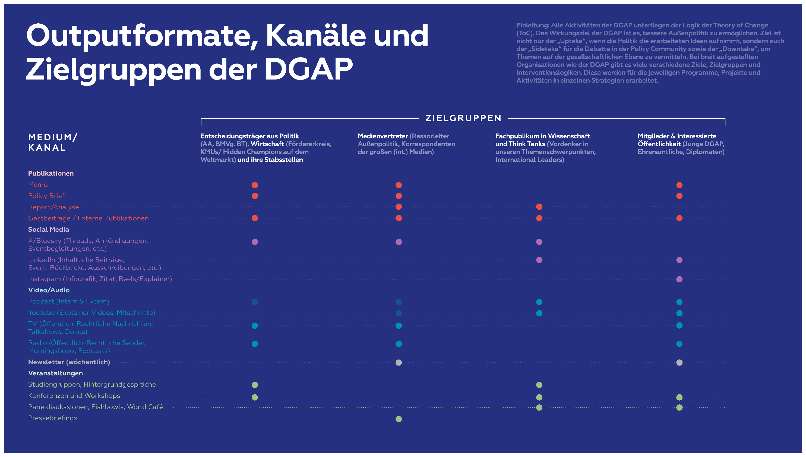
The output forms of the DGAP

Slide 9


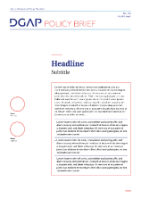
PUBLICATION
FORMATS (1)
(S) MEMO
Assesses a topical foreign policy issue objectively and concisely
Crunches new data or information OR
Highlights upcoming political intelligence that we want to put on the political community's radar OR
Repackages longer research we have previously done but that is now politically relevant so that it draws clear, practical conclusions for the here and now
4,000 to 9,000 characters
POLICY BRIEF
Summarizes the relevant points related to an issue of foreign policy and distills them into recommendations for decision-makers
12,000 to 20,000 characters
Graphic(s) to support the topic are recommended
Layout in DGAP template mandatory
Website: always full text online incl. graphics
Social Media: Twitter Thread by author or via @dgapev recommended

Slide 10
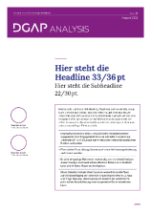
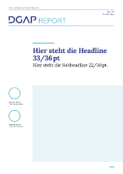
PUBLICATION
FORMATS (2)
ANALYSIS
A well documented point of reference with recommendations for the debate on a complex policy issue
50,000 to 110,000 characters, Executive summary of 4,500- 8,000 characters mandatory
Graphic(s) to support the topic are recommended
Layout in DGAP template mandatory
Website: Teaser & executive summary, in general no upload of the full text.
REPORT
Format is flexible (issue paper, edited volume, workshop report, etc.)
Alternative formats like Power Point Presentation or Video-Report could be possible
Website: Teaser & executive summary, in general no upload of the full text.
External Publications
Format is flexible (issue paper, edited volume, workshop report, etc.)
Website: Teaser & executive summary, in general no upload of the full text.

Slide 11

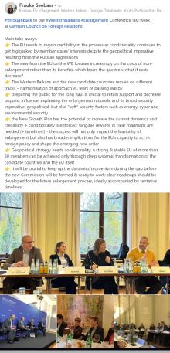
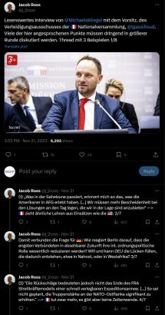
Social Media

Slide 12
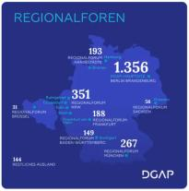

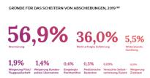
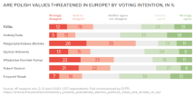

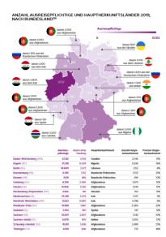


GRAPHICS

Slide 13
WIKI
Our publication guidelines can be found on the DGAP Wiki: https://wiki.dgap.org/books/publikationen/chapter/dgap-publication-guidelines-english
Corporate design manual (logo, templates etc.)
https://wiki.dgap.org/books/dgap-corporate-design/page/dgap-logo-claim
Invitation Editing Guidelines
https://wiki.dgap.org/books/einladungsredaktion-invite-editing

Slide 14







THE COMMUNICATIONS TEAM
WIEBKE EWERING
Head of
Communications
Full Time
HELGA BECK
Editor EN
Part Time, 50%
Mon, Tue, Wed
JANA IDRIS
Editor DE
Full Time
PATRICK GRÜNHAG
Social Media
Full Time
LUISE ROMBACH
Graphic Design
Full Time
HENDRIK WERNER
Audio Video Editor
Full Time
ANDREAS ALVAREZ
Y SEMTNER
Head of IT & Website Admin
Part Time for Comms, 15%
Support by external service providers
Student Assistance
JULIA GRONENBERG (covering
for INA GEORGIEVA
Graphic Design
LARA BÜHRER
Editors
BETTINA VESTRING, MARK McQUAY
NICK BOUCHET, et.al.

